Slide 1
Mining Massive Datasets
Wu-Jun Li
Department of Computer Science and Engineering
Shanghai Jiao Tong University
Lecture 9: Supervised Learning -- Classification

Slide 2
Spam filtering: classification task
Classification Problem
From: "" <takworlld@hotmail.com>
Subject: real estate is the only way... gem oalvgkay
Anyone can buy real estate with no money down
Stop paying rent TODAY !
There is no need to spend hundreds or even thousands for similar courses
I am 22 years old and I have already purchased 6 properties using the
methods outlined in this truly INCREDIBLE ebook.
Change your life NOW !
=================================================
Click Below to order:
http://www.wholesaledaily.com/sales/nmd.htm
=================================================

Slide 3
Supervised Learning --- Classification
Classification Problem
Given:
  A description of a point, d ∈ X
  A fixed set of classes:
  C = {c₁, c₂,…, c_{J}}
  A training set D of labeled points with each labeled document ⟨d,c⟩∈X×C
Determine:
  A learning method or algorithm which will enable us to learn a classifier f:X→C
  For a test point d, we assign it the class f(d) ∈ C

Slide 4
Document Classification
Classification Problem
“planning
language
proof
intelligence”
Test
Data:
(AI)
(Programming)
(HCI)
Classes:
ML
Planning
Semantics
Garb.Coll.
Multimedia
GUI
Training
Data:
learning
intelligence
algorithm
reinforcement
network...
planning
temporal
reasoning
plan
language...
programming
semantics
language
proof...
garbage
collection
memory
optimization
region...
...
...
(Note: in real life there is often a hierarchy, not present in the above problem statement; and also, you get papers on ML approaches to Garb. Coll.)

Slide 5
More Classification Examples
Many search engine functionalities use classification
Classification Problem
Assigning labels to documents or web-pages:
Labels are most often topics such as Yahoo-categories
  "finance," "sports," "news>world>asia>business"
Labels may be genres
  "editorials" "movie-reviews" "news”
Labels may be opinion on a person/product
  “like”, “hate”, “neutral”
Labels may be domain-specific
  "interesting-to-me" : "not-interesting-to-me”
  “contains adult language” : “doesn’t”
  language identification: English, French, Chinese, …
  search vertical: about Linux versus not
  “link spam” : “not link spam”

Slide 6
Classification Methods
Perceptrons (refer to lecture 9.2)
Naïve Bayes
kNN
Support vector machine (SVM)

Slide 7
Bayesian Methods
Naïve Bayes
Learning and classification methods based on probability theory.
Bayes theorem plays a critical role in probabilistic learning and classification.
Builds a generative model that approximates how data is produced
Uses prior probability of each category given no information about an item.
Categorization produces a posterior probability distribution over the possible categories given a description of an item.

Slide 8
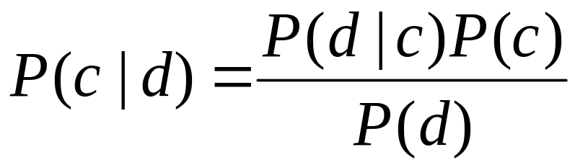
Bayes’ Rule for classification
Naïve Bayes
For a point d and a class c

Slide 9
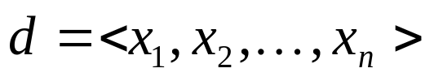
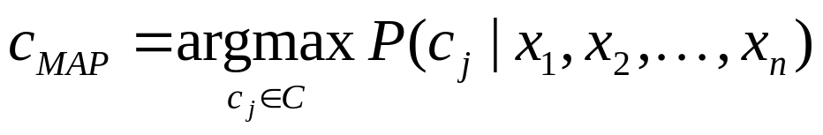
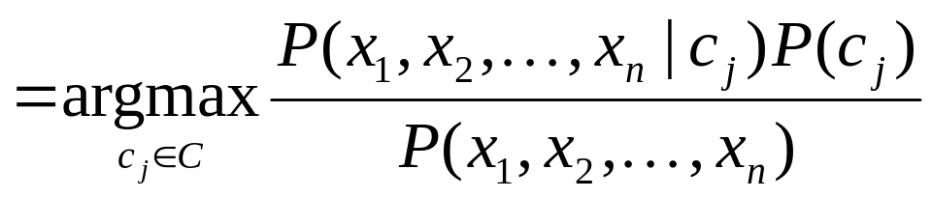
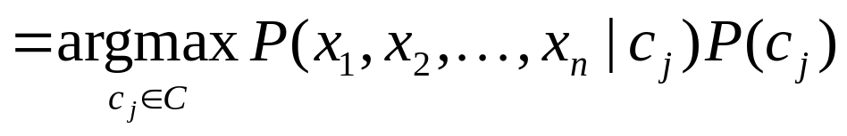
Naive Bayes Classifiers
Naïve Bayes
Task: Classify a new point d based on a tuple of attribute values into one of the classes c_{j} ∈ C
MAP is “maximum a posteriori” = most likely class

Slide 10
Naïve Bayes Classifier:
Naïve Bayes Assumption
Naïve Bayes
P(c_{j})
  Can be estimated from the frequency of classes in the training examples.
P(x₁,x₂,…,x_{n}|c_{j})
  O(|X|^{n}•|C|) parameters
  Could only be estimated if a very, very large number of training examples was available.
Naïve Bayes Conditional Independence Assumption:
Assume that the probability of observing the conjunction of attributes is equal to the product of the individual probabilities P(x_{i}|c_{j}).

Slide 11
The Naïve Bayes Classifier
Naïve Bayes
Flu
X₁
X₂
X₃
X₄
X₅
runnynose
sinus
cough
fever
muscle-ache
Conditional Independence Assumption: features detect term presence and are independent of each other given the class:

Slide 12
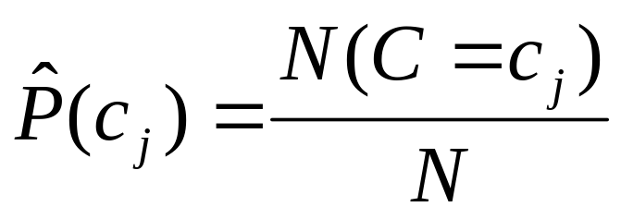
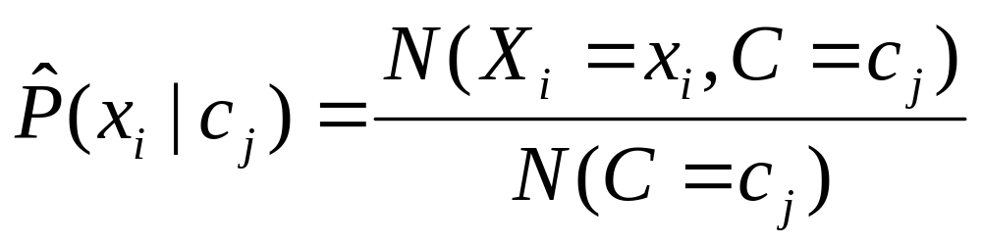
Learning the Model
Naïve Bayes
C
X₁
X₂
X₃
X₄
X₅
X₆
First attempt: maximum likelihood estimates
  simply use the frequencies in the data

Slide 13
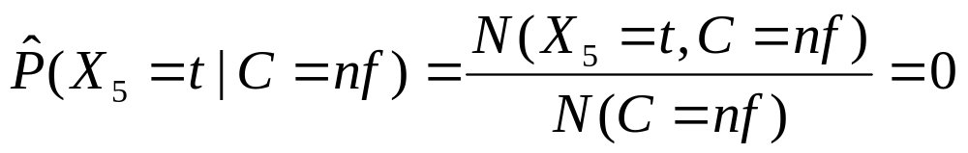
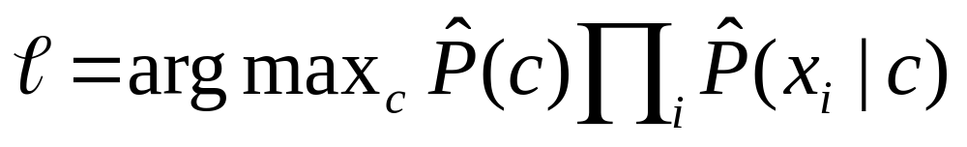
Problem with Maximum Likelihood
Naïve Bayes
Flu
X₁
X₂
X₃
X₄
X₅
runnynose
sinus
cough
fever
muscle-ache
What if we have seen no training documents with the word muscle-ache and classified in the topic Flu?
Zero probabilities cannot be conditioned away, no matter the other evidence!

Slide 14
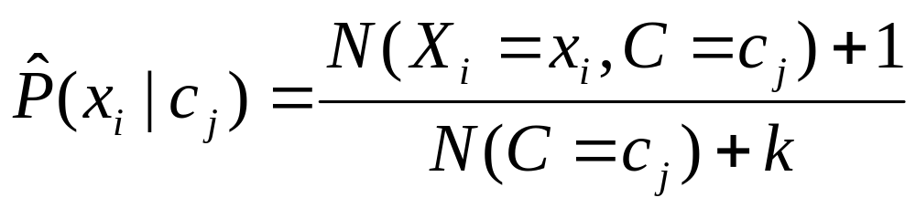
Smoothing to Avoid Overfitting
Naïve Bayes
Laplace smoothing:
# of values of X_{i}
Notes:
Note that this was discussed in the review section, for giving better estimates in the spelling correction exercise.

Slide 15
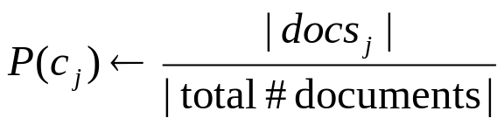
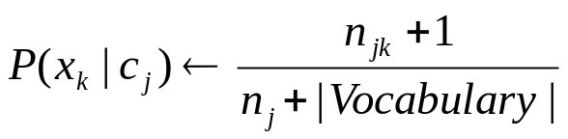
Naive Bayes: Learning
Running example: document classification
Naïve Bayes
From training corpus, extract Vocabulary
Calculate required P(c_{j}) and P(x_{k} | c_{j}) terms
  For each c_{j} in C do
    docs_{j} ← subset of documents for which the target class is c_{j}
    Text_{j} ← single document containing all docs_{j}
    for each word x_{k} in Vocabulary
      n_{jk} ← number of occurrences of x_{k} in Text_{j}
      n_{j}← number of words in Text_{j}

Slide 16
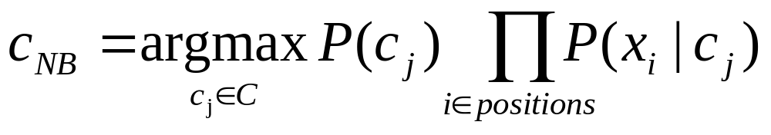
Naive Bayes: Classifying
Naïve Bayes
positions ← all word positions in current document which contain tokens found in Vocabulary
Return c_{NB}, where

Slide 17
Naive Bayes: Time Complexity
Naïve Bayes
For document classification:
Training Time: O(|D|L_{ave} + |C||V|)) where L_{ave} is the average length of a document in D.
  Assumes all counts are pre-computed in O(|D|L_{ave}) time during one pass through all of the data.
  Generally just O(|D|L_{ave}) since usually |C||V| < |D|L_{ave}
Test Time: O(|C| L_{t}) where L_{t} is the average length of a test document.
Very efficient overall, linearly proportional to the time needed to just read in all the data.

Slide 18
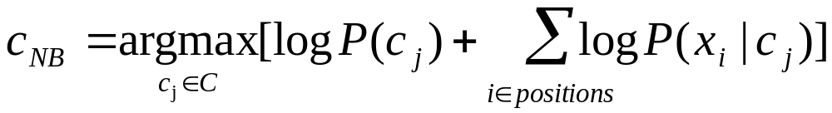
Underflow Prevention: using logs
Naïve Bayes
Multiplying lots of probabilities, which are between 0 and 1 by definition, can result in floating-point underflow.
Since log(xy) = log(x) + log(y), it is better to perform all computations by summing logs of probabilities rather than multiplying probabilities.
Class with highest final un-normalized log probability score is still the most probable.
Note that model is now just max of sum of weights…

Slide 19
Naive Bayes Classifier
Naïve Bayes
Simple interpretation: Each conditional parameter log P(x_{i}|c_{j}) is a weight that indicates how good an indicator x_{i} is for c_{j}.
The prior log P(c_{j}) is a weight that indicates the relative frequency of c_{j}.
The sum is then a measure of how much evidence there is for the document being in the class.
We select the class with the most evidence for it

Slide 20
Classification Methods
Perceptrons
Naïve Bayes
kNN
Support vector machine (SVM)

Slide 21
k Nearest Neighbor Classification
K Nearest Neighbor
kNN = k Nearest Neighbor
To classify a point d into class c:
Define k-neighborhood N as k nearest neighbors of d
Count number of points i in N that belong to c
Estimate P(c|d) as i/k
Choose as class argmax_{c} P(c|d) [ = majority class]

Slide 22
Example: k=6 (6NN)
K Nearest Neighbor
P(science| )?
Government
Science
Arts

Slide 23
Nearest-Neighbor Learning Algorithm
K Nearest Neighbor
Learning is just storing the representations of the training examples in D.
Testing instance x (under 1NN):
  Compute similarity between x and all examples in D.
  Assign x the category of the most similar example in D.
Also called:
  Case-based learning
  Memory-based learning
  Lazy learning
Rationale of kNN: contiguity hypothesis

Slide 24
k Nearest Neighbor
K Nearest Neighbor
Using only the closest example (1NN) to determine the class is subject to errors due to:
  A single atypical example.
  Noise (i.e., an error) in the category label of a single training example.
More robust alternative is to find the k most-similar examples and return the majority category of these k examples.
Value of k is typically odd to avoid ties; 3 and 5 are most common.

Slide 25
kNN decision boundaries
K Nearest Neighbor
Boundaries are in principle arbitrary surfaces – but usually polyhedra
Government
Science
Arts
kNN gives locally defined decision boundaries between
classes – far away points do not influence each classification
decision (unlike in Naïve Bayes, etc.)

Slide 26
Similarity Metrics
K Nearest Neighbor
Nearest neighbor method depends on a similarity (or distance) metric.
Simplest for continuous m-dimensional instance space is Euclidean distance.
Simplest for m-dimensional binary instance space is Hamming distance (number of feature values that differ).
For text, cosine similarity of tf.idf weighted vectors is typically most effective.

Slide 27
kNN: Discussion
K Nearest Neighbor
Scales well with large number of classes
  Don’t need to train n classifiers for n classes
Classes can influence each other
  Small changes to one class can have ripple effect
Scores can be hard to convert to probabilities
No training necessary
  Actually: perhaps not true. (Data editing, etc.)
May be expensive at test time
In most cases it’s more accurate than NB

Slide 28
Classification Methods
Perceptrons
Naïve Bayes
kNN
Support vector machine (SVM)

Slide 29
Separation by Hyperplanes
Linear Vs Nonlinear
A common assumption is linear separability:
  in 2 dimensions, can separate classes by a line
  in higher dimensions, need hyperplanes
Can find separating hyperplane by linear programming
  (or can iteratively fit solution via perceptron):
  separator can be expressed as ax + by = c

Slide 30
Linear programming / Perceptron
Linear Vs Nonlinear
Find a,b,c, such that
ax + by > c for red points
ax + by < c for blue points.

Slide 31
Which Hyperplane?
Linear Vs Nonlinear
In general, lots of possible
solutions for a,b,c.

Slide 32
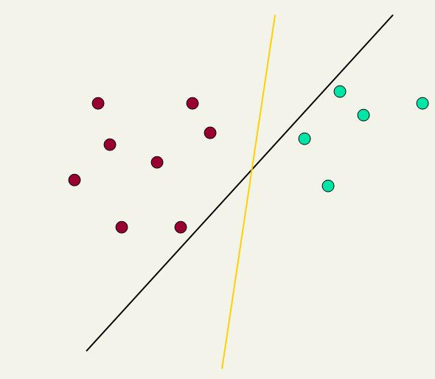
Which Hyperplane?
Linear Vs Nonlinear
Lots of possible solutions for a,b,c.
Some methods find a separating hyperplane, but not the optimal one [according to some criterion of expected goodness]
  E.g., perceptron
Most methods find an optimal separating hyperplane
Which points should influence optimality?
  All points
    Linear/logistic regression
    Naïve Bayes
  Only “difficult points” close to decision boundary
    Support vector machines

Slide 33
Linear classifier: Example
Linear Vs Nonlinear
Class: “interest” (as in interest rate)
Example features of a linear classifier
w_{i} t_{i} w_{i} t_{i}
To classify, find dot product of feature vector and weights
0.70 prime
0.67 rate
0.63 interest
0.60 rates
0.46 discount
0.43 bundesbank
−0.71 dlrs
−0.35 world
−0.33 sees
−0.25 year
−0.24 group
−0.24 dlr

Slide 34
Linear Classifiers
Linear Vs Nonlinear
Many common text classifiers are linear classifiers
  Naïve Bayes
  Perceptron
  Rocchio
  Logistic regression
  Support vector machines (with linear kernel)
  Linear regression with threshold
Despite this similarity, noticeable performance differences
  For separable problems, there is an infinite number of separating hyperplanes. Which one do you choose?
  What to do for non-separable problems?
  Different training methods pick different hyperplanes

Slide 35
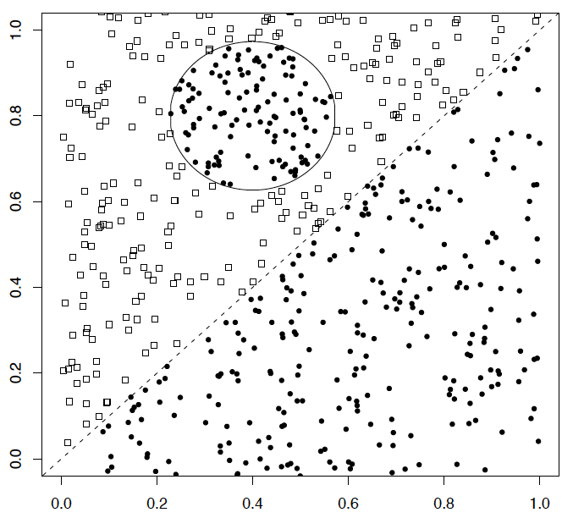
A nonlinear problem
Linear Vs Nonlinear
A linear classifier does badly on this task
kNN will do very well (assuming enough training data)

Slide 36
Linear classifiers: Which Hyperplane?
Support Vector Machine
Lots of possible solutions for a, b, c.
Some methods find a separating hyperplane, but not the optimal one [according to some criterion of expected goodness]
  E.g., perceptron
Support Vector Machine (SVM) finds an optimal solution.
  Maximizes the distance between the hyperplane and the “difficult points” close to decision boundary
  One intuition: if there are no points near the decision surface, then there are no very uncertain classification decisions
This line represents the decision boundary:
ax + by − c = 0
Notes:
But note that Naïve Bayes also finds an optimal solution … just under a different definition of optimality.

Slide 37
Support Vector Machine (SVM)
Support Vector Machine
SVMs maximize the margin around the separating hyperplane.
    A.k.a. large margin classifiers
The decision function is fully specified by a subset of training samples, the support vectors.
Solving SVMs is a quadratic programming problem
Seen by many as the most successful current text classification method*
Support vectors
Maximizes
margin
Narrower
margin
*but other discriminative methods often perform very similarly

Slide 38
Maximum Margin: Formalization
Support Vector Machine
w: decision hyperplane normal vector
x_{i}: data point i
y_{i}: class of data point i (+1 or -1) Note: Not 1/0
Classifier is: f(x_{i}) = sign(w^{T}x_{i} + b)

Slide 39
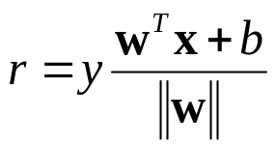
Geometric Margin
Support Vector Machine
Distance from example to the separator is
Examples closest to the hyperplane are support vectors.
Margin ρ of the separator is the width of separation between support vectors of classes.
x
ρ
Derivation of finding r:
Dotted line x’−x is perpendicular to
decision boundary so parallel to w.
Unit vector is w/||w||, so line is rw/||w||.
x’ = x – yrw/||w||.
x’ satisfies w^{T}x’+b = 0.
So w^{T}(x –yrw/||w||) + b = 0
Recall that ||w|| = sqrt(w^{T}w).
So, solving for r gives:
r = y(w^{T}x + b)/||w||
r
x′
w
Notes:
Looking for distance r. Dotted line x’-x is perpendicular to decision boundary so parallel to w. Unit vector is w/|w|, so this one is rw/|w|.
x’ = x – rw/|w|. X’ satisfies wx+b = 0.
So wT(x –rw/|w|) + b = 0
Recall that |w| = sqrt(wTw). So, solving for r gives:
r = y(wTx + b)/|w|

Slide 40
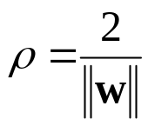
Linear SVM Mathematically
The linearly separable case
Support Vector Machine
Assume that all data is at least distance 1 from the hyperplane, then the following two constraints follow for a training set {(x_{i} ,y_{i})}
For support vectors, the inequality becomes an equality
Then, since each example’s distance from the hyperplane is
The margin is:
w^{T}x_{i} + b ≥ 1 if y_{i} = 1
w^{T}x_{i} + b ≤ -1 if y_{i} = -1

Slide 41
Linear Support Vector Machine (SVM)
Support Vector Machine
ρ
w^{T}x_{a} + b = 1
Hyperplane
w^{T} x + b = 0
Extra scale constraint:
min_{i=1,…,n} |w^{T}x_{i} + b| = 1
This implies:
w^{T}(x_{a}–x_{b}) = 2
ρ = ||x_{a}–x_{b}||₂ = 2/||w||
w^{T}x_{b} + b = -1
w^{T} x + b = 0

Slide 42
Linear SVMs Mathematically (cont.)
Support Vector Machine
Then we can formulate the quadratic optimization problem:
A better formulation (min ||w|| = max 1/ ||w|| ):
Find w and b such that
is maximized; and for all {(x_{i} , y_{i})}
w^{T}x_{i} + b ≥ 1 if y_{i}=1; w^{T}x_{i} + b ≤ -1 if y_{i} = -1
Find w and b such that
Φ(w) =½ w^{T}w is minimized;
and for all {(x_{i} ,y_{i})}: y_{i} (w^{T}x_{i} + b) ≥ 1

Slide 43
Solving the Optimization Problem
Support Vector Machine
This is now optimizing a quadratic function subject to linear constraints --- quadratic programming
Quadratic programming problems are a well-known class of mathematical programming problem, and many (intricate) algorithms exist for solving them (with many special ones built for SVMs)
The solution involves constructing a dual problem where a Lagrange multiplier α_{i} is associated with every constraint in the primary problem:
Find w and b such that
Φ(w) =½ w^{T}w is minimized;
and for all {(x_{i} ,y_{i})}: y_{i} (w^{T}x_{i} + b) ≥ 1
Find α₁…α_{N} such that
Q(α) =Σα_{i} - ½ΣΣα_{i}α_{j}y_{i}y_{j}x_{i}^{T}x_{j} is maximized and
(1) Σα_{i}y_{i} = 0
(2) α_{i} ≥ 0 for all α_{i}

Slide 44
The Optimization Problem Solution
Support Vector Machine
The solution has the form:
Each non-zero α_{i} indicates that corresponding x_{i} is a support vector.
Then the classifying function will have the form:
Notice that it relies on an inner product between the test point x and the support vectors x_{i} – we will return to this later.
Also keep in mind that solving the optimization problem involved computing the inner products x_{i}^{T}x_{j} between all pairs of training points.
w =Σα_{i}y_{i}x_{i} b= y_{k}- w^{T}x_{k} for any x_{k} such that α_{k}≠ 0
f(x) = Σα_{i}y_{i}x_{i}^{T}x + b

Slide 45
Soft Margin Classification
Support Vector Machine
If the training data is not linearly separable, slack variables ξ_{i} can be added to allow misclassification of difficult or noisy examples.
Allow some errors
  Let some points be moved to where they belong, at a cost
Still, try to minimize training set errors, and to place hyperplane “far” from each class (large margin)
ξ_{i}
ξ_{j}

Slide 46
Soft Margin Classification Mathematically
Support Vector Machine
The old formulation:
The new formulation incorporating slack variables:
Parameter C can be viewed as a way to control overfitting – a regularization term
Find w and b such that
Φ(w) =½ w^{T}w is minimized and for all {(x_{i} ,y_{i})}
y_{i} (w^{T}x_{i} + b) ≥ 1
Find w and b such that
Φ(w) =½ w^{T}w + CΣξ_{i} is minimized and for all {(x_{i} ,y_{i})}
y_{i} (w^{T}x_{i} + b) ≥ 1- ξ_{i} and ξ_{i} ≥ 0 for all i

Slide 47
Soft Margin Classification – Solution
Support Vector Machine
The dual problem for soft margin classification:
Neither slack variables ξ_{i} nor their Lagrange multipliers appear in the dual problem!
Again, x_{i} with non-zero α_{i} will be support vectors.
Solution to the dual problem is:
Find α₁…α_{N} such that
Q(α) =Σα_{i} - ½ΣΣα_{i}α_{j}y_{i}y_{j}x_{i}^{T}x_{j} is maximized and
(1) Σα_{i}y_{i} = 0
(2) 0 ≤ α_{i} ≤ C for all α_{i}
w is not needed explicitly for classification!
w = Σα_{i}y_{i}x_{i}
b = y_{k}(1- ξ_{k}) - w^{T}x_{k} where k = argmax α_{k’}
k’
f(x) = Σα_{i}y_{i}x_{i}^{T}x + b

Slide 48
Classification with SVMs
Support Vector Machine
Given a new point x, we can score its projection onto the hyperplane normal:
  I.e., compute score: w^{T}x + b = Σα_{i}y_{i}x_{i}^{T}x + b
  Can set confidence threshold t.
Score > t: yes
Score < -t: no
Else: don’t know
1
0
-1

Slide 49
Linear SVMs: Summary
Support Vector Machine
The classifier is a separating hyperplane.
The most important training points are the support vectors; they define the hyperplane.
Quadratic programming algorithms can identify which training points x_{i} are support vectors with non-zero Lagrangian multipliers α_{i}.
Both in the dual formulation of the problem and in the solution, training points appear only inside inner products:
Find α₁…α_{N} such that
Q(α) =Σα_{i} - ½ΣΣα_{i}α_{j}y_{i}y_{j}x_{i}^{T}x_{j} is maximized and
(1) Σα_{i}y_{i} = 0
(2) 0 ≤ α_{i} ≤ C for all α_{i}
f(x) = Σα_{i}y_{i}x_{i}^{T}x + b

Slide 50
Non-linear SVMs
Support Vector Machine
Datasets that are linearly separable (with some noise) work out great:
But what are we going to do if the dataset is just too hard?
How about … mapping data to a higher-dimensional space:
0
x
0
x
x²
0
x

Slide 51
Non-linear SVMs: Feature spaces
Support Vector Machine
General idea: the original feature space can always be mapped to some higher-dimensional feature space where the training set is separable:
Φ: x → φ(x)

Slide 52
The “Kernel Trick”
Support Vector Machine
The linear classifier relies on an inner product between vectors K(x_{i},x_{j})=x_{i}^{T}x_{j}
If every datapoint is mapped into high-dimensional space via some transformation Φ: x → φ(x), the inner product becomes:
K(x_{i},x_{j})= φ(x_{i}) ^{T}φ(x_{j})
A kernel function is some function that corresponds to an inner product in some expanded feature space.
Example:
2-dimensional vectors x=[x₁ x₂]; let K(x_{i},x_{j})=(1 + x_{i}^{T}x_{j})²,
Need to show that K(x_{i},x_{j})= φ(x_{i}) ^{T}φ(x_{j}):
K(x_{i},x_{j})=(1 + x_{i}^{T}x_{j})²,= 1+ x_{i1}²x_{j1}² + 2 x_{i1}x_{j1} x_{i2}x_{j2}+ x_{i2}²x_{j2}² + 2x_{i1}x_{j1} + 2x_{i2}x_{j2}=
= [1 x_{i1}² √2 x_{i1}x_{i2} x_{i2}² √2x_{i1} √2x_{i2}]^{T} [1 x_{j1}² √2 x_{j1}x_{j2} x_{j2}² √2x_{j1} √2x_{j2}]
= φ(x_{i}) ^{T}φ(x_{j}) where φ(x) = [1 x₁² √2 x₁x₂ x₂² √2x₁ √2x₂]

Slide 53

Kernels
Support Vector Machine
Why use kernels?
  Make non-separable problem separable.
  Map data into better representational space
Common kernels
  Linear
  Polynomial K(x,z) = (1+x^{T}z)^{d}
    Gives feature conjunctions
  Radial basis function (infinite dimensional space)

Slide 54
Evaluation

Slide 55
Evaluation: Classic Reuters-21578 Data Set
Evaluation
Most (over)used data set in information retrieval
21578 documents
9603 training, 3299 test articles (ModApte/Lewis split)
118 categories
  An article can be in more than one category
  Learn 118 binary category distinctions
Average document: about 90 types, 200 tokens
Average number of classes assigned
  1.24 for docs with at least one category
Only about 10 out of 118 categories are large
Common categories
(#train, #test)
Earn (2877, 1087)
Acquisitions (1650, 179)
Money-fx (538, 179)
Grain (433, 149)
Crude (389, 189)
Trade (369,119)
Interest (347, 131)
Ship (197, 89)
Wheat (212, 71)
Corn (182, 56)

Slide 56
Reuters Text Categorization data set (Reuters-21578) document
Evaluation
<REUTERS TOPICS="YES" LEWISSPLIT="TRAIN" CGISPLIT="TRAINING-SET" OLDID="12981" NEWID="798">
<DATE> 2-MAR-1987 16:51:43.42</DATE>
<TOPICS><D>livestock</D><D>hog</D></TOPICS>
<TITLE>AMERICAN PORK CONGRESS KICKS OFF TOMORROW</TITLE>
<DATELINE> CHICAGO, March 2 - </DATELINE><BODY>The American Pork Congress kicks off tomorrow, March 3, in Indianapolis with 160 of the nations pork producers from 44 member states determining industry positions on a number of issues, according to the National Pork Producers Council, NPPC.
Delegates to the three day Congress will be considering 26 resolutions concerning various issues, including the future direction of farm policy and the tax law as it applies to the agriculture sector. The delegates will also debate whether to endorse concepts of a national PRV (pseudorabies virus) control and eradication program, the NPPC said.
A large trade show, in conjunction with the congress, will feature the latest in technology in all areas of the industry, the NPPC added. Reuter
&#3;</BODY></TEXT></REUTERS>

Slide 57


Good practice department:
Confusion matrix
Evaluation
This (i, j) entry of the confusion matrix means of the points actually in class i were put in class j by the classifier.
Class assigned by classifier
Actual Class
53
In a perfect classification, only the diagonal has non-zero entries

Slide 58
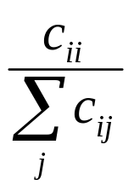
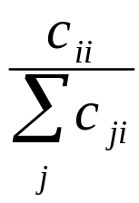
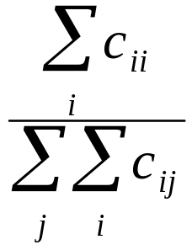
Per class evaluation measures
Evaluation
Recall: Fraction of points in class i classified correctly:
Precision: Fraction of points assigned class i that are actually about class i:
Accuracy: (1 - error rate) Fraction of points classified correctly:

Slide 59
Micro- vs. Macro-Averaging
Evaluation
If we have more than one class, how do we combine multiple performance measures into one quantity?
  Macroaveraging: Compute performance for each class, then average.
  Microaveraging: Collect decisions for all classes, compute contingency table, evaluate.

Slide 60
Micro- vs. Macro-Averaging: Example
Evaluation
Confusion matrices:
Class 1
Class 2
Micro Ave. Table
 | Classifier: yes | Classifier: no
Truth: yes | 10 | 10
Truth: no | 10 | 970
 | Classifier: yes | Classifier: no
Truth: yes | 90 | 10
Truth: no | 10 | 890
 | Classifier: yes | Classifier: no
Truth: yes | 100 | 20
Truth: no | 20 | 1860
Macroaveraged precision: (0.5 + 0.9)/2 = 0.7
Microaveraged precision: 100/120 = .83
Microaveraged score is dominated by score on common classes

Slide 61
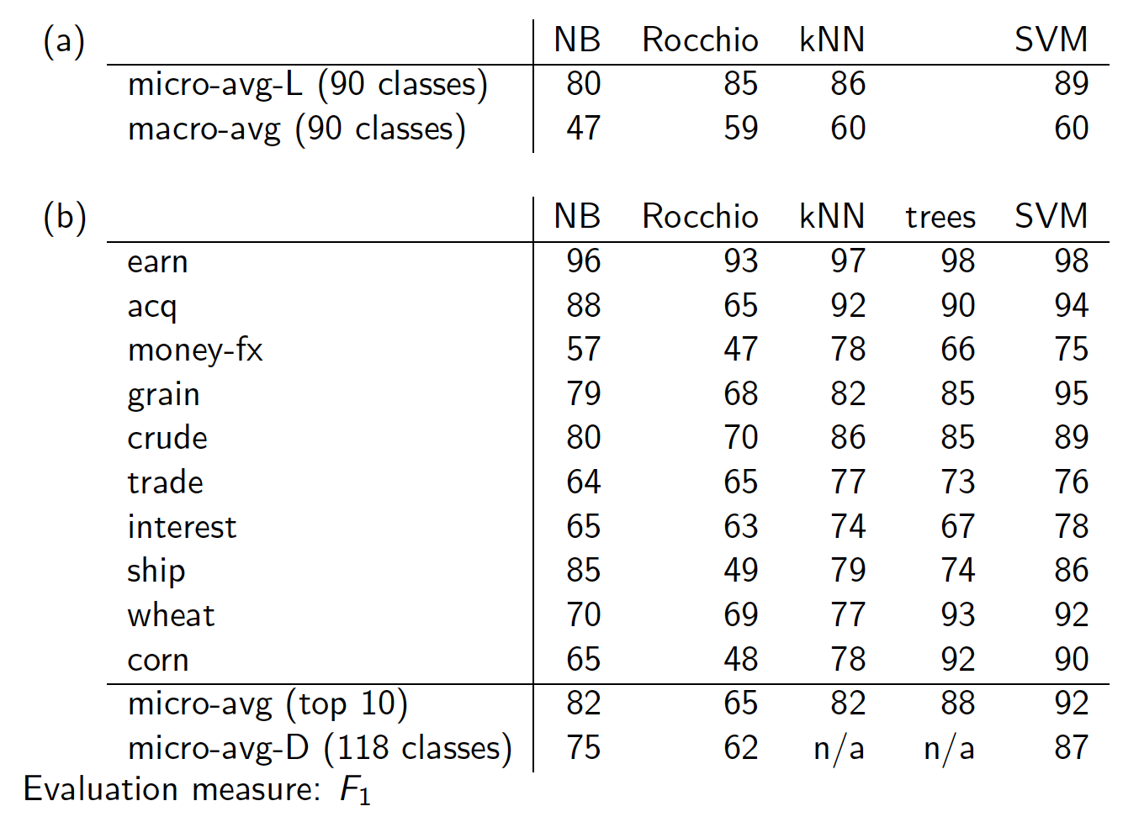
Evaluation

Slide 62
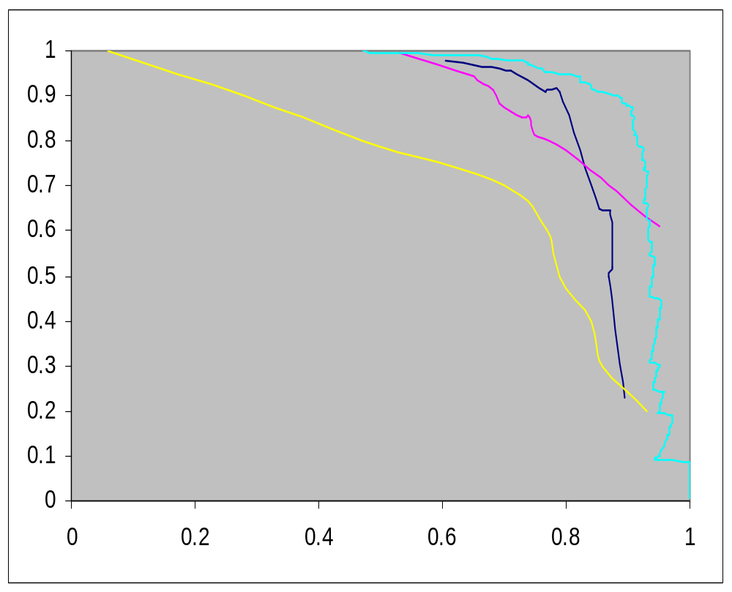
Precision-recall for category: Crude
Evaluation
Recall
LSVM
Decision Tree Naïve Bayes
Rocchio
Dumais (1998)
Precision

Slide 63
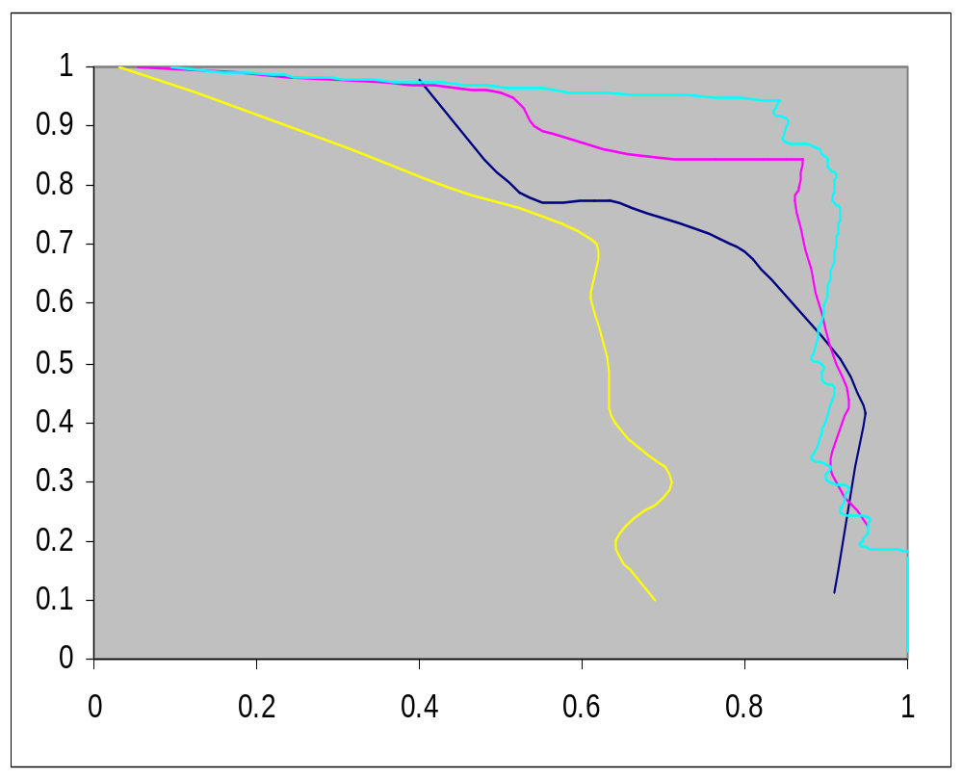
Precision-recall for category: Ship
Evaluation
Recall
LSVM
Decision Tree Naïve Bayes
Rocchio
Dumais (1998)
Precision

Slide 64
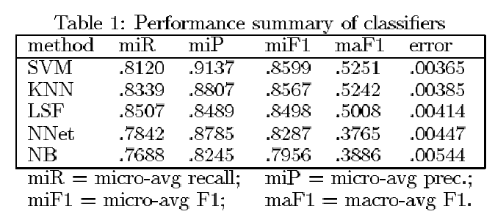
Yang&Liu: SVM vs. Other Methods
Evaluation

Slide 65
Resources
Trevor Hastie, Robert Tibshirani and Jerome Friedman, Elements of Statistical Learning: Data Mining, Inference and Prediction. Springer-Verlag, New York.
Weka: A data mining software package that includes an implementation of many ML algorithms

Slide 66
Acknowledgement
Slides are adapted from
  Prof. Christopher D. Manning

